Slide 1


HOW TO WRITE
A PARAGRAPH
.

Slide 2

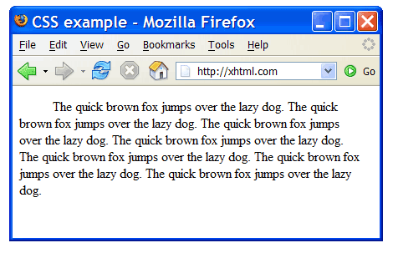
What is a Paragraph
A paragraph is a piece of writing
that consists of one or more sentences. Sometimes, the first line is indented.
Indentation

Slide 3
PARTS OF A PARAGRAPH
A paragraph regularly has three parts:
1. Topic Sentence: It is usually the first sentence in a paragraph.
2. Supporting Sentences: They support the information of the topic sentence. It includes specific details
3. Conclusion: It reminds what the topic sentence was about.

Slide 4
PARAGRAPH SAMPLE
My Dog Romeo is so much fun to play with. One reason he’s fun is because he loves to play catch. What’s also fun is that he follows me around the house with a toy and drops it on my foot, so I will kick it. Additionally, he can catch just about anything, but his favorite thing to catch is a Frisbee. Finally, he loves it when I pretend like I’m falling dead, and he runs over to lick me. All these reasons show why I really have fun playing with Romeo.
Red is the topic sentence
Blue is the supporting details
Brown is the conclusion.

Slide 5

PROCESS TO WRITING A PARAGRAPH

Slide 6

There are five steps to write a good paragraph.

Slide 7

1. Brainstorming
In this step you should think and write down any ideas about a topic you want to write about.

Slide 8
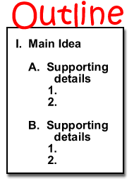
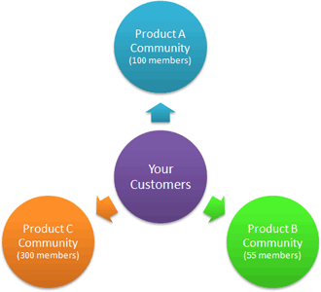
2. ORGANIZING IDEAS
In this step you should organize your ideas by creating a cluster or an outline about what you want to write about.
Cluster

Slide 9
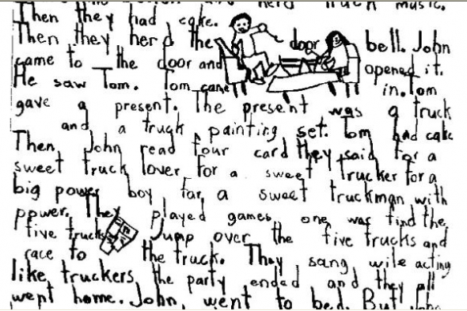
3. WRITING THE FIRST DRAFT
In this step you should write your paragraph for the first time, not taking much into account about the cohesion, coherence grammar, or spelling.

Slide 10
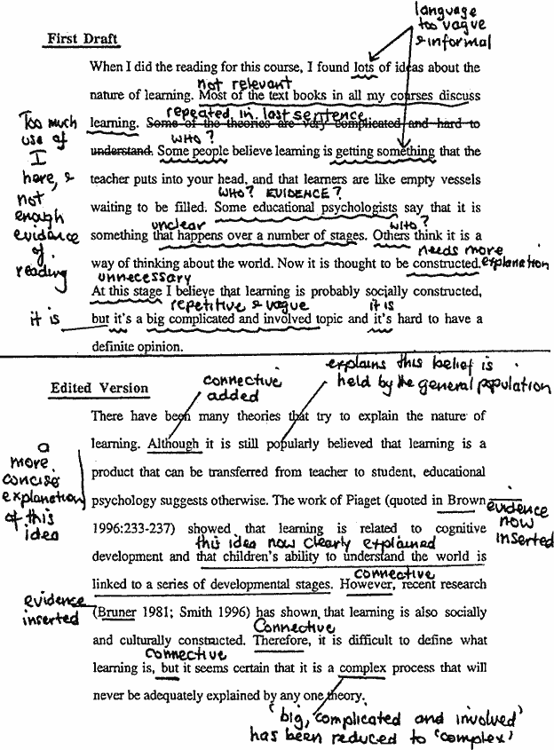
4. EDITING
In this step you should revise all the errors abut coherence and cohesion that your paragraph may have.

Slide 11
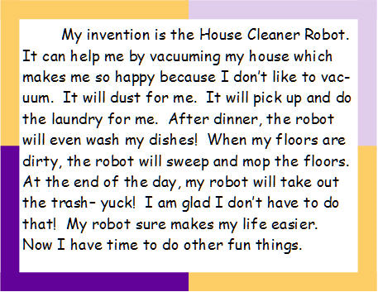
5. FINAL WORK
In this step you should revise all the spelling or grammar errors. And that’s it. Your paragraph is done !

Slide 12
GOOD
JOB!

